Slide 1
Relational Database Design

Slide 2
Designing a Relational Database: Overview
Determine purpose of database
Find & organize information required
Create Entity-Relationship (E-R) diagram
Refine design
Apply normalization rules
PIER-RN
Follow this process for the Library example on the homework.

Slide 3
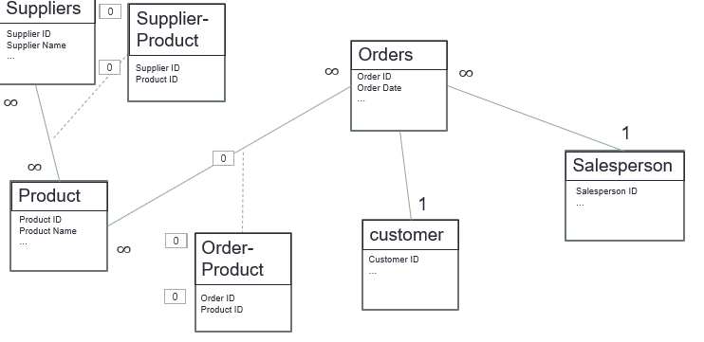
Create Entity-Relationship (E-R) diagram

Slide 4
Designing a Relational Database: Overview
Determine purpose of database
Find & organize information required
Create Entity-Relationship (E-R) diagram
Refine design
Apply normalization rules
PIER-RN
Follow this process for the Library example on the homework.

Slide 5
Example: Order tracking in a single spreadsheet
This approach has some shortcomings (what are they?)
Consider designing a database instead
Notes:
Shortcomings:
- Lots of redundancy
- Lots of room for human error
- Too much information in one field– what if you wanted to search for all customers in a specific state? Is there any way to do that easily with the data in the current format?
- What if the person ordered more than one product? More rows? List the product? Add more columns?

Slide 6
I. Determine purpose of the database
Determine purpose of database
Find & organize information required
Create Entity-Relationship (E-R) diagram
Refine design
Apply normalization rules
How?
In general: a database is utilized to track information in an efficient, usable way
In this order tracking example:
the purpose of the database is to track orders to include all information contained in the existing spreadsheet

Slide 7
II. Find & organize information required
Determine purpose of database
Find & organize information required
Create Entity-Relationship (E-R) diagram
Refine design
Apply normalization rules
How?
Identify within the data the:
entities
attributes (of the entities)
and organize these
Looking at the data in the spreadsheet below, what are they?
Notes:
Working left to right across columns – order is a noun, salesperson is a noun, date is an attribute of an order, customer is a noun, cust. Contact info is an attribute of customer, product is a noun – with attributes: id, unit price; quantity is an attribute of order; supplier is a noun with contact as attribute
Order Details: Order #, Salesperson, Date, Quantity[idf]
Customer: Customer Name, Customer contact info
Product: Product ID, price[idf]?
Supplier: Supplier Contact

Slide 8
Determine purpose of database
Find & organize information required
Create Entity-Relationship (E-R) diagram
Refine design
Apply normalization rules
II. Find & organize information required
Order # | Salesperson | Date | Customer name | Customer contact info | Product ID | Quantity | Supplier | Supplier contact | price
Customer
Order Details
Products
Suppliers
Organizing information in our order spreadsheet into entities:
  Customers
  Products
  Suppliers
  Order details

Slide 9
II. Find & organize information required
Determine purpose of database
Find & organize information required
Create Entity-Relationship (E-R) diagram
Refine design
Apply normalization rules
Entity | Attributes
Customer
Product
Suppliers
Orders
Notes:
:
:

Slide 10
II. Find & organize information required
Determine purpose of database
Find & organize information required
Create Entity-Relationship (E-R) diagram
Refine design
Apply normalization rules
Entity | Attributes
Customer | name, salutation, address, phone #
Product | product name, price, units in stock, units on order
Suppliers | company name, contact name, address
Orders | order ID, salesperson, date, product name, quantity, product price
Notes:
:
:

Slide 11
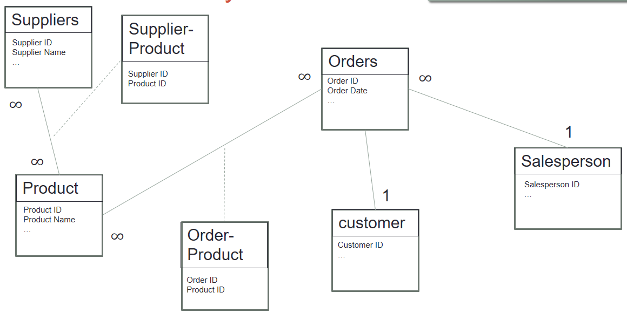
III. Create Entity-Relationship (E-R) diagram
Determine purpose of database
Find & organize information required
Create Entity-Relationship (E-R) diagram
Refine design
Apply normalization rules
When we’re done, it will look something like this:

Slide 12
Background on ER Diagrams
Entity-Relationship Diagrams were introduced by Peter Chen¹ in 1976
Introduced as a technique for modeling data with a specific application to databases
Unified Modeling Language (UML) was introduced as common design language for the development of computer applications².
In our introduction to databases in this course, we will create E-R diagrams using UML (see “Entity Relationship Modeling with UML” article posted in the course repo)

Slide 13
ER Modeling with UML:
Representing Entities with their Attributes
Student
This is an entity-type.
The header describes the entity-type, and the items listed are the attributes (fields)
Section
Last Name
First Name
ID
Grad Yr
Section #
Location
Instructor
Meeting Time
Course
Course
Course Name
Course #
Dept
Notes:
The rectangle with the entity-type at the top, filled in with the attributes below follows UML. In OOP, this is used to represent a class, and would have a third section below the attributes that would encompass the methods of the class.

Slide 14
ER Diagrams (cont.)
Recall: Cardinality of Relationships between Entities
One-to-one:
  Each instance of Entity A related to 1 instance of Entity B
  Each instance of Entity B related to 1 instance of Entity A
  Ex. People : SSNs
One-to-many:
  Each instance of Entity A related to many instances of Entity B
  Each instance of Entity B related to 1 instance of Entity A
  Ex. Bus driver : passengers
Many-to-many:
  Each instance of Entity A related to many instances of Entity B
  Each instance of Entity B related to many instances of Entity A
  Ex. Ingredients : recipes

Slide 15

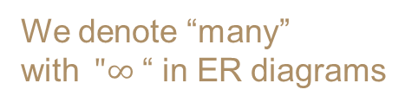


ER Diagram
Now adding in Cardinality
Section
recall this relationship is many-to-many
Section #
Location
Instructor
Meeting Time
Course
Student
$$∞$$
Last Name
First Name
ID
Grad Yr
$$∞$$
$$∞$$
recall this relationship is one-to-many
Course
1
We denote “many” with$"∞$ “ in ER diagrams
Course Name
Course #
Dept
Each entity becomes a table in the database.

Slide 16
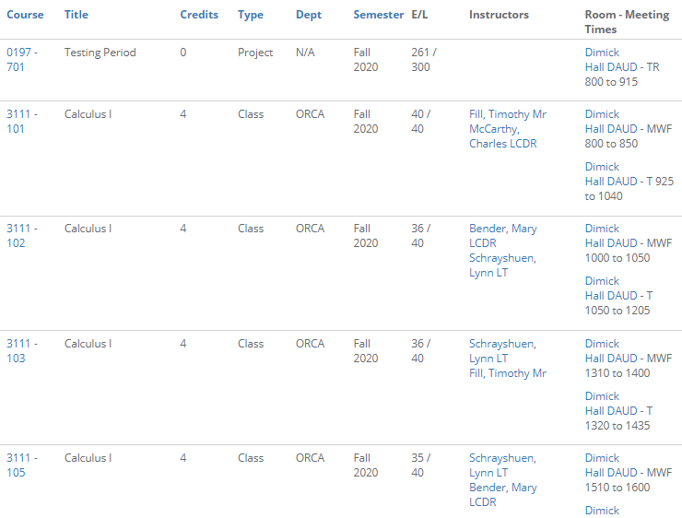
The “Section” Table
We can see the connection to Course – 1 course per section, many sections per course
How do we connect this table to the Student table?
  Put all section students in the row?
  What about the students’ other information (code, class year, …)?
Instead…
Notes:
The student table would capture all of the student’s info: Name, grad year, code, DOB, etc
The section table would capture all of the section’s info: Parent course, location, meeting time
How could we capture the relationship between these two tables?
Without a third table it would require repetition in one of the tables...
One student’s information could be repeated in the student table, and an additional section field would list a different section that the student was enrolled in for each entry into this student table.
By creating a third table, this table only requires the primary key from both tables in the many-to-many relationship.

Slide 17



Create a new table between entities in a many-to-many relationship
The new table contains the primary keys from each of the original tables (linking it to each of those tables)
These keys are called “foreign keys” since they are (primary) keys from a “foreign” table
Additional fields can be added as needed/desired
Student-Section
Section
Student ID #
Section #
Section #
Location
Instructor
Meeting Time
Course
$$∞$$
$$∞$$
Student
Last Name
First Name
Student ID#
Grad Yr
$$∞$$
Course
1
Course Name
Course #
Dept
Notes:
For the student-section relationship, the third table should be called ‘Student-Section’ (explicitly describes the purpose of the table), and only requires the Student PK and Section PK

Slide 18



Create a new table between entities in a many-to-many relationship
Stu ID# | Sec # | more fields…
131057 | 3336-101 | …
131057 | 3411-101
131057 | 2239-102
131982 | 3336-101
131982 | 4144-105
132527 | 3336-101
Student-Section
Section
Student ID #
Section #
Section #
Location
Instructor
Meeting Time
Course
Something like
← this
$$∞$$
$$∞$$
Note:
Neither field can be a primary key (why not?)
But they can be used together as a compound key
(e.g. 131057/3336-101) (why?)
Student
Last Name
First Name
Student ID#
Grad Yr
$$∞$$
Course
1
Course Name
Course #
Dept
Notes:
For the student-section relationship, the third table should be called ‘Student-Section’ (explicitly describes the purpose of the table), and only requires the Student PK and Section PK

Slide 19
Database Design Considerations due to Cardinality
  Many-to-many relationship
    A third table must be created consisting of the primary keys from each individual table (results in one-to-many relationship)
  One-to-many relationship
    Primary key of the “one” is inserted as a foreign key into the “many”
  One-to-one relationship
    Can the tables be combined?

Slide 20
III. Create Entity-Relationship (E-R) diagram
Determine purpose of database
Find & organize information required
Create Entity-Relationship (E-R) diagram
Refine design
Apply normalization rules
Back to the orders database example
Draw entities with attributes
Customer
Product
Suppliers
Orders
Name
Salutation
Address
Phone number
Product name
Price
Units in stock
Units on order
Company name
Contact name
Address
Order ID
Salesperson
Date
Product
Quantity
Total
What are the cardinalities between the entities?
Do we need to add any entities?
Notes:
Customer to product: many to many
A customer can have many products; a product can belong to many customers
Customer to supplier: not a direct link
Customer to order: one to many
A customer can have many orders; an order can have one customer
Orders to product: many to many
An order can have many product; a product can belong to many orders
Need another table: order-product
Orders to supplier: through a product
Product to supplier: many to many
A product can have many suppliers; a supplier can have many products
Need another table: supplier product
Consider adding a salesperson entity

Slide 21










III. Create ER Diagram
Represent relationships & indicate cardinality
Determine purpose of database
Find & organize information required
Create Entity-Relationship (E-R) diagram
Refine design
Apply normalization rules
Suppliers
Supplier ID
Supplier Name
…
Orders
$$∞$$
$$∞$$
Order ID
Order Date
…
$$∞$$
1
$$∞$$
$$∞$$
Salesperson
Product
1
Salesperson ID
…
Product ID
Product Name
…
customer
$$∞$$
Customer ID
…
Notes:
For the many-to-many relationships, a third table must be created.
Only the primary keys from the tables in the many-to-many relationship must be in this third table.
Went ahead and added a Salesperson entity. This seems like a logical place to capture the sales person data, so the name, contact info, etc does not have to be entered for each salesperson on each order. With a salesperson table, only the salesperson ID has to be added to the order table to build this relationship.

Slide 22

III. Create ER Diagram
Represent relationships & indicate cardinality
Determine purpose of database
Find & organize information required
Create Entity-Relationship (E-R) diagram
Refine design
Apply normalization rules
Suppliers
Supplier-Product
Supplier ID
Supplier Name
…
Orders
Supplier ID
Product ID
$$∞$$
$$∞$$
Order ID
Order Date
…
$$∞$$
$$∞$$
1
$$∞$$
Salesperson
Product
1
Salesperson ID
…
Product ID
Product Name
…
customer
$$∞$$
Order-Product
Customer ID
…
Order ID
Product ID
Notes:
For the many-to-many relationships, a third table must be created.
Only the primary keys from the tables in the many-to-many relationship must be in this third table.
Went ahead and added a Salesperson entity. This seems like a logical place to capture the sales person data, so the name, contact info, etc does not have to be entered for each salesperson on each order. With a salesperson table, only the salesperson ID has to be added to the order table to build this relationship.
Idf: ** KEY SLIDE **

Slide 23
Create tables based off of ER Diagram
Created because of many-to-many relationship

Slide 24
IV. Refine your design
Determine purpose of database
Find & organize information required
Create Entity-Relationship (E-R) diagram
Refine design
Apply normalization rules
Is/are there any:
  columns you forgot?
  unnecessary columns?
  duplicate or redundant information?
  tables with many empty fields?
Is information divided into smallest useful parts?
Does each column contain a fact about the table’s subject?

Slide 25
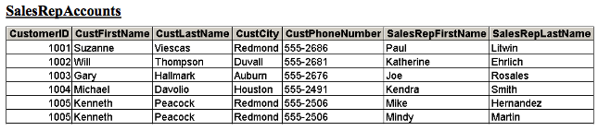
Minimize redundant data
Example:
What is wrong with using a table like this?
Notes:
All of the data for a given customer must be repeated when another sales rep is assigned to that customer

Slide 26
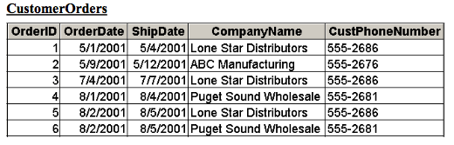
another example
What is wrong with using a table like this?
Notes:
If lone star distributors change its name, then you’d have to update it in three spots

Slide 27
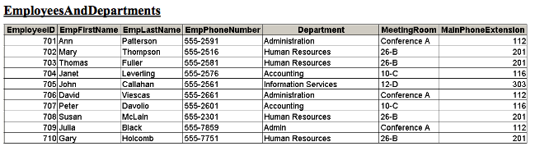
Divide information into its smallest usable components
Example:
What are the problems with using a table like this?
Notes:
Cannot enter data for a new department until you have at least one employee assigned to the department
Cannot add a new employee unless you’re ready to assign him/her to a particular department

Slide 28
V. Apply normalization
rules
Determine purpose of database
Find & organize information required
Create Entity-Relationship (E-R) diagram
Refine design
Apply normalization rules
Goals of Normalization:
information retrieved from the database is accurate and reliable
database can be efficiently updated and managed
Normalization achieves this through:
Imposing efficient database structure using rules
  e.g. Minimizing amount of redundant data, and other approaches

Slide 29
V. Apply normalization
rules
Determine purpose of database
Find & organize information required
Create Entity-Relationship (E-R) diagram
Refine design
Apply normalization rules
Process of Normalization
Begin by ensuring:
  Each table has a primary key
  Tables do not contain repeating groups of data
Next ensure the Normal Forms are followed:
First Normal Form (1NF)
  At every column and row intersection in a table, there is only one, single value (no lists).
Second Normal Form (2NF)
  In 1NF plus each non-key column is fully dependent on the entire primary key, not just part of it.
Third Normal Form (3NF)
  In 2NF plus all non-key columns must be independent of each other.
Notes:
Wikipedia: Database normalization is the process of structuring a relational database in accordance with a series of so-called normal forms in order to reduce data redundancy and improve data integrity.
Via 1 of the links:
A database is in third normal form if it satisfies the following conditions:
It is in second normal form
There is no transitive functional dependency - By transitive functional dependency, we mean we have the following relationships in the table: A is functionally dependent on B, and B is functionally dependent on C. In this case, C is transitively dependent on A via B.

Slide 30
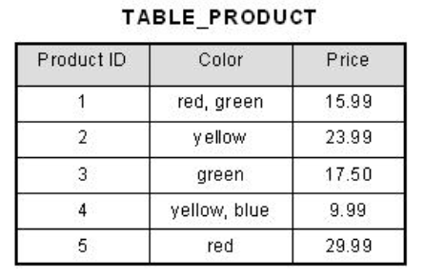
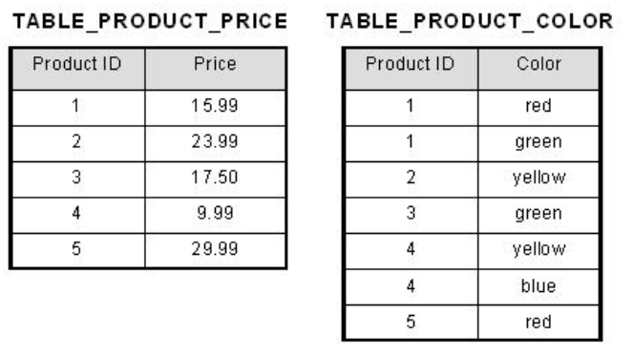
First Normal Form
Determine purpose of database
Find & organize information required
Create Entity-Relationship (E-R) diagram
Refine design
Apply normalization rules
At every column and row intersection in a table, there is only one, single value (no lists)
1NF
now First Normal Form is satisfied
not in First Normal Form
color has multiple values

Slide 31
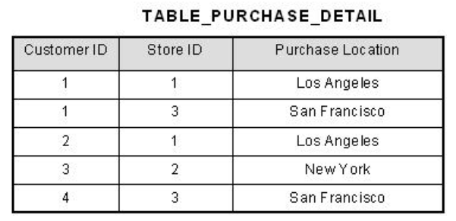
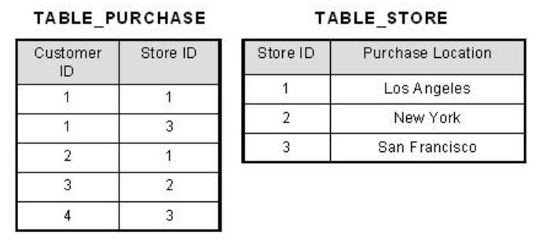
Second Normal Form
Determine purpose of database
Find & organize information required
Create Entity-Relationship (E-R) diagram
Refine design
Apply normalization rules
Each non-key column is fully dependent on the entire primary key, not just part of it
Now non-key columns fully dependent on primary key,
Second Normal Form is satisfied.
2NF
Primary key is [Cust. ID, Store ID], e.g. [1,1] or [3,2].
Location does not depend on one of those keys – Cust. ID.
Table does not satisfy Second Normal Form
Break into 2 tables…

Slide 32
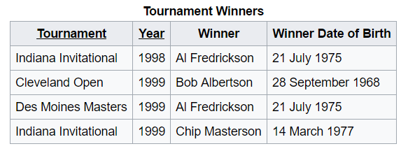
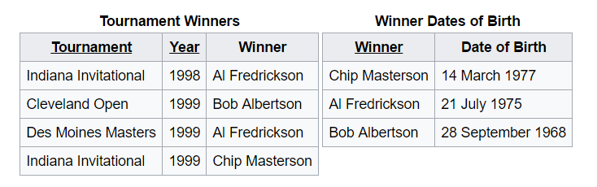
Third Normal Form
Determine purpose of database
Find & organize information required
Create Entity-Relationship (E-R) diagram
Refine design
Apply normalization rules
All non-key columns must be independent of each other
‘Tournament’ and ‘Year’ are the compound primary key.
‘Winner’ and ‘winner DOB’ are not independent of each other.
3NF
Now in Third Normal Form

Slide 33
Design a Database:
Feline Novelties Example
Variation of Case 1 from textbook
We’ll follow this example for each step in the design process.
Background: Your friend, Michelle, has approached you about a start-up business she has created. Michelle has always been a cat lover and knows that many of her friends share her love of felines. She has always wanted to be her own boss and has begun to sell specialty cat toys and treats on a monthly basis to her friends locally. The initial reaction to her business has been strong, and she has enlisted your help to computerize her ordering system.

Slide 34

Feline Novelties Example
How the business works:
Customers can sign up for monthly boxes to contain cat toys, treats, and other goodies geared towards cats.
Customers pay a monthly fee that is debited to their credit cards and automatically receive a box of goodies.
Cats have fickle natures, so the new toys and treats are a delight to them and hence to their owners.
Currently, Michelle uses a third party that takes care of credit card payments.
She wants you to concentrate on the ordering side of the business.
You suggest creating an Access database to track and record all orders for her small business. You have experience using the program from your IS coursework.

Slide 35
Feline Novelties Example
Later, address these questions Michelle has:
Michelle knows that some of the cats’ toys are geared towards female owners. She is curious to know the gender of her customers, so she can buy appropriate items to fill the monthly boxes.
Michelle began the business with the idea of selling only boxes of toys and treats, but now she is expanding to sell other items. She would like to know how many monthly items have been purchased so far because she suspects these items are still the bulk of her business.
Notes:
Anytime you see grumpy cat, we’ll visit this example

Slide 36

Designing a Relational Database:
Overview
Determine purpose of database
Find & organize information required
Create Entity-Relationship (E-R) diagram
Refine design
Apply normalization rules
Notes:
Run through this process in class

Slide 37
I. Determine Purpose
Determine purpose of database
Find & organize information required
Create Entity-Relationship (E-R) diagram
Refine design
Apply normalization rules
What is the purpose of the Feline Novelties Database?
Do this, next few slides on white board / notes.
Notes:
See notes / do on whiteboard

Slide 38
II. Find & organize information required
Determine purpose of database
Find & organize information required
Create Entity-Relationship (E-R) diagram
Refine design
Apply normalization rules
What are the entities?
What are their attributes?

Slide 39
III. Create Entity-Relationship (E-R) diagram
Determine purpose of database
Find & organize information required
Create Entity-Relationship (E-R) diagram
Refine design
Apply normalization rules
Determine relationships between entities
Determine cardinalities of relationships
Apply adjustments based on cardinalities:
- for example, many-to-many requires new table

Slide 40
IV. Refine your design
V. Apply normalization rules
Determine purpose of database
Find & organize information required
Create Entity-Relationship (E-R) diagram
Refine design
Apply normalization rules
For now, let’s mainly focus on ensuring that the three normal forms are being followed.

Slide 41
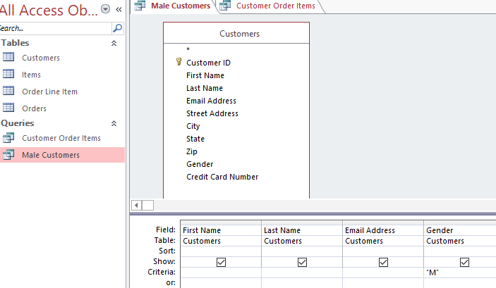
Feline Novelties Example
Build in Access –
see feline-blank.accdb, feline_data.xlsx, etc.
Try to build simple queries:
  List of customer names (requires one table)
  List of customer names who are female (requires one table with one criterion)
  List of customer names and items they have ordered (requires more than one table)
Select desired fields from desired tables
Add criteria as necessary, e.g. Gender is ‘M’
Choose Create : Query Design

Slide 42
Database Design
iterative process
create it, populate it, evaluate it, improve it
Some examples in slides from and more information available at: https://www.1keydata.com/database-normalization/

